Slide 1

PRINTING I SIGNAGES I RETAIL
Signage's | Printing | Retail In-shop Fixtures
| Retail Branding
| Marketing Collaterals

Slide 2


About us
Our 30,000 square feet facility in Mundka with state-of-the-art technology enables us to manufacture all tyoes of production and help our customers turn their products/services into immersive experinces.
Our services extends from ideating and customizing to creating and installing.
LAKSHYA SIGNAGES. Is an NCR-
based Branding & Retail Merchandizing studio that offers
turnkey solutions to retailers and
corporations.
Handled at the core by young, enthusiastic and experienced leaders, LAKSHYA SIGNAGES is committed to providing hassle-free and seamless solutions to all its clients.
Within a short span of less than 13 years, we have managed to touch base with one of the leading names in the market who’ve trusted and appreciated our innovative design skills, quality and deliveries.
We have a fully integrated crew with 150+staff comprising of in-house designers, project managers, furniture department, painter & welder team as well as tech support team.

Slide 3




Founder Profile
Mr. Sunny Thakur, Founder & Director of Lakshya Signages, is a visionary entrepreneur and branding strategist with 15+ years of industry experience. Starting his journey in Delhi with just ₹1,500, he has built Lakshya Signages into a trusted partner for leading brands, delivering impactful signage, printing, and visual branding solutions.
He is also the author of “The Growth Multiplier for Brands”, a book that shares real-world insights on branding, business growth, trust, teamwork, and execution excellence. The book reflects his philosophy that growth comes through partnerships, creativity, and efficiency, values that strongly define Lakshya Signages’ culture.
Driven by people-first leadership and continuous learning, Sunny Thakur continues to inspire brands and teams to scale with purpose and impact.
Now Available on

Slide 4

Our Vision
To emmerge as a leading and progressive retail interior and branding support company by providing contemporary and innovaitve solutions that bring optimum change in the performance of our clients.
Our Mission
Develop long term client relationships through innovative solutions by promising round the clock support & service.

Slide 5


What Makes Us Different
• End-to-End In-House Production
From concept to installation — every stage handled under one roof for complete control and consistency.
• Fastest Turnaround Times
Optimized workflows, skilled teams, and high-capacity production that ensure quick delivery without compromising quality.
• Design + Fabrication + Installation
Integrated capabilities that bring ideas to life with accuracy, speed, and flawless on-ground execution.
• Multi-City Rollout Expertise
Proven experience in delivering brand-consistent signage across multiple cities, stores, and formats.
• Retail-Focused Innovation & Smart Materials
Advanced materials, modern display solutions, and future-ready designs built specifically for retail environments.
• Strict Quality Control Processes
8-step QC standards that ensure precision, durability, and a perfect finish every single time.
• High-Precision Machinery
State-of-the-art equipment for accurate cutting, printing, bending, welding, and fabrication.
• 24/7 Client Support & Project Governance
Dedicated teams for updates, coordination, and seamless project management round the clock.

Slide 6
Our Services
Branding
Large Format Printing
Signage & Branding
Variable data printing
Digital Graphics
Design & Retail Consulting
Offset Printing
Marketing Collaterals
POP Collaterals
Emboss UV Printing
Retail Interior
2D & 3D Designing
Retail Shop fits
Display Racks, Display Counters, Island
Units, Shop-in-shops
Modular/non-modular furniture using
wood, acrylic or metal in various finishes
Flooring, False Ceiling, Paint Job
Promotional Materials

Slide 7
Our Manufacturing Capabilities
Branding
HP LATEX
Colorjet flex printing (2)
HP Digital 5100
Epson Sure Color (2)
Various Cutting Machines
UV Flat Bed printing Machine-
UV flat Bed Embossed Printing
Digital Cutter
Retail Interior
Acrylic Laser Cutting
Panel Saw
Edge Bending
Wooden Tools
CNC Router
In-house automated Paint Booth
Channel Banding Machine
Mini Fixing

Slide 8
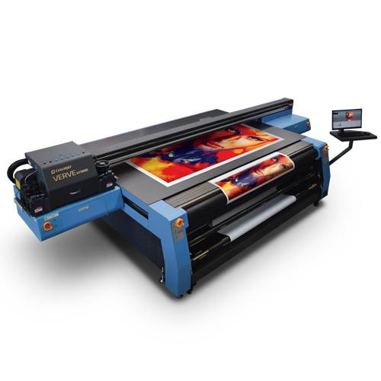
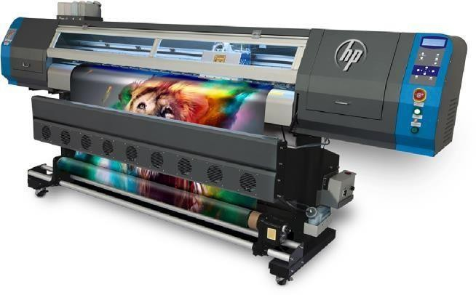
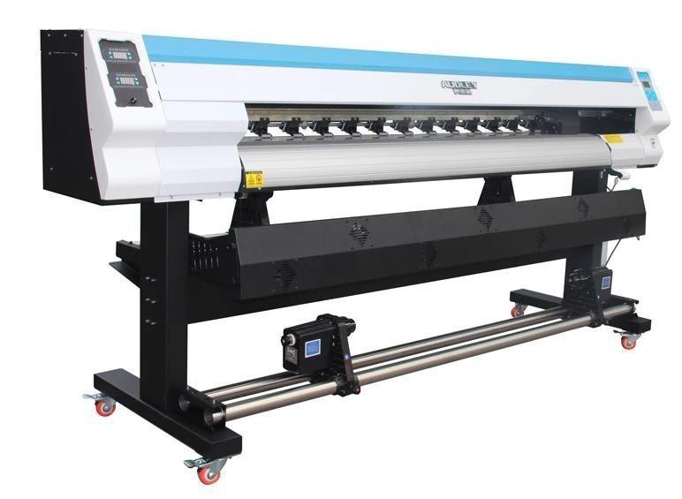
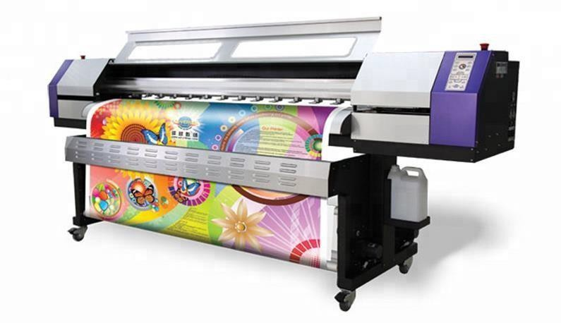
In-house machinery
UV PRINTING MACHINE
FLEX PRINTING MACHINE
ECO SOLVENT PRINTER
DIGITAL PRINTING MACHINE

Slide 9
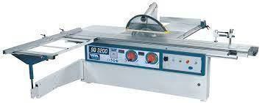
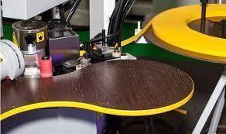
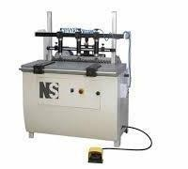
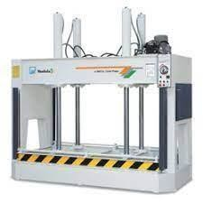
In-house machinery
PANEL SAW
EDGE BANDING
MINI FIXING
COLD PRESS

Slide 10
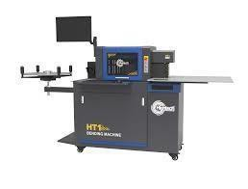
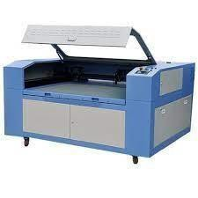
In-house machinery
Plastic Lazer
Automatic Channel Letter Bending Machine

Slide 11

Our Process
. Understanding the Brief
. Research & Analysis
. 2D/3D Concept Development
. Prototyping & Sampling
. Manufacturing
. Quality Validation
. Packaging & Logistics
. On-Site Installation
. After-Sales Support

Slide 12
Quality Control Process
Material Inspection
Ensuring only approved, high-grade materials are used
Color Calibration
Brand-accurate shades matched across all outputs
Lighting Uniformity Check
Consistent brightness and illumination levels
Strength & Durability Testing
Verifying long-term performance and safety
Finishing Inspection
Smooth edges, clean surfaces, and premium detailing
Packaging QC
Safe, damage-proof packing for transit
On-Site Installation Review
Alignments, levels, and site-readiness checks
Post-Installation Audit
Final validation before project handover

Slide 13
3D DESIGN VISUALIZATION

Slide 14
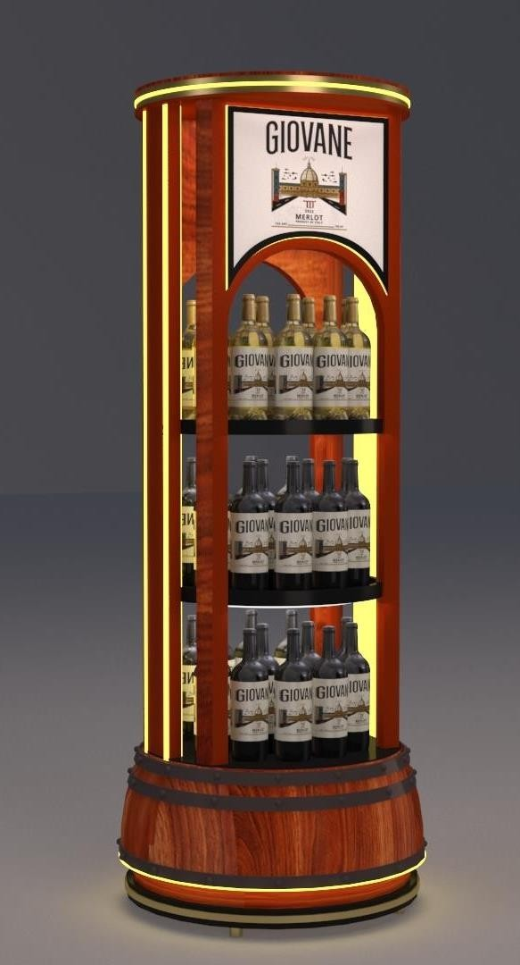
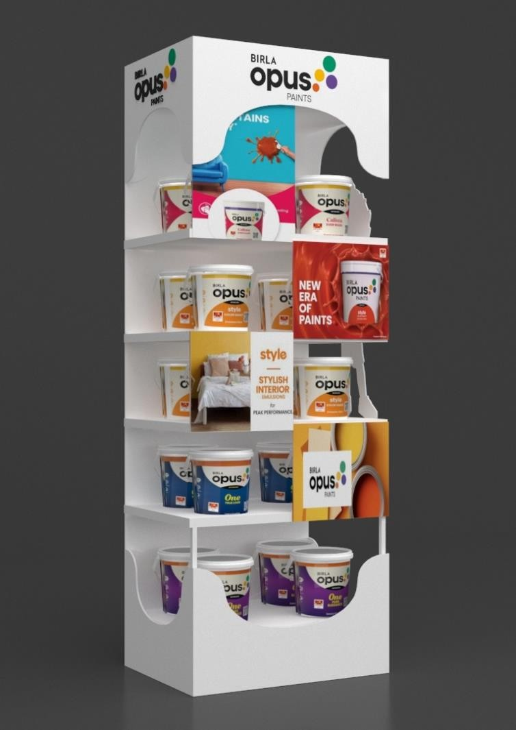
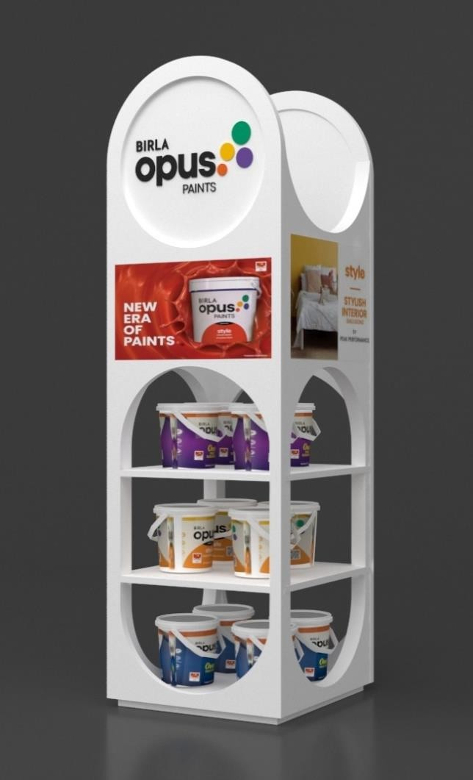
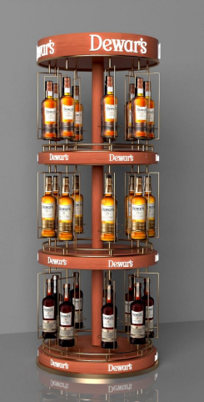
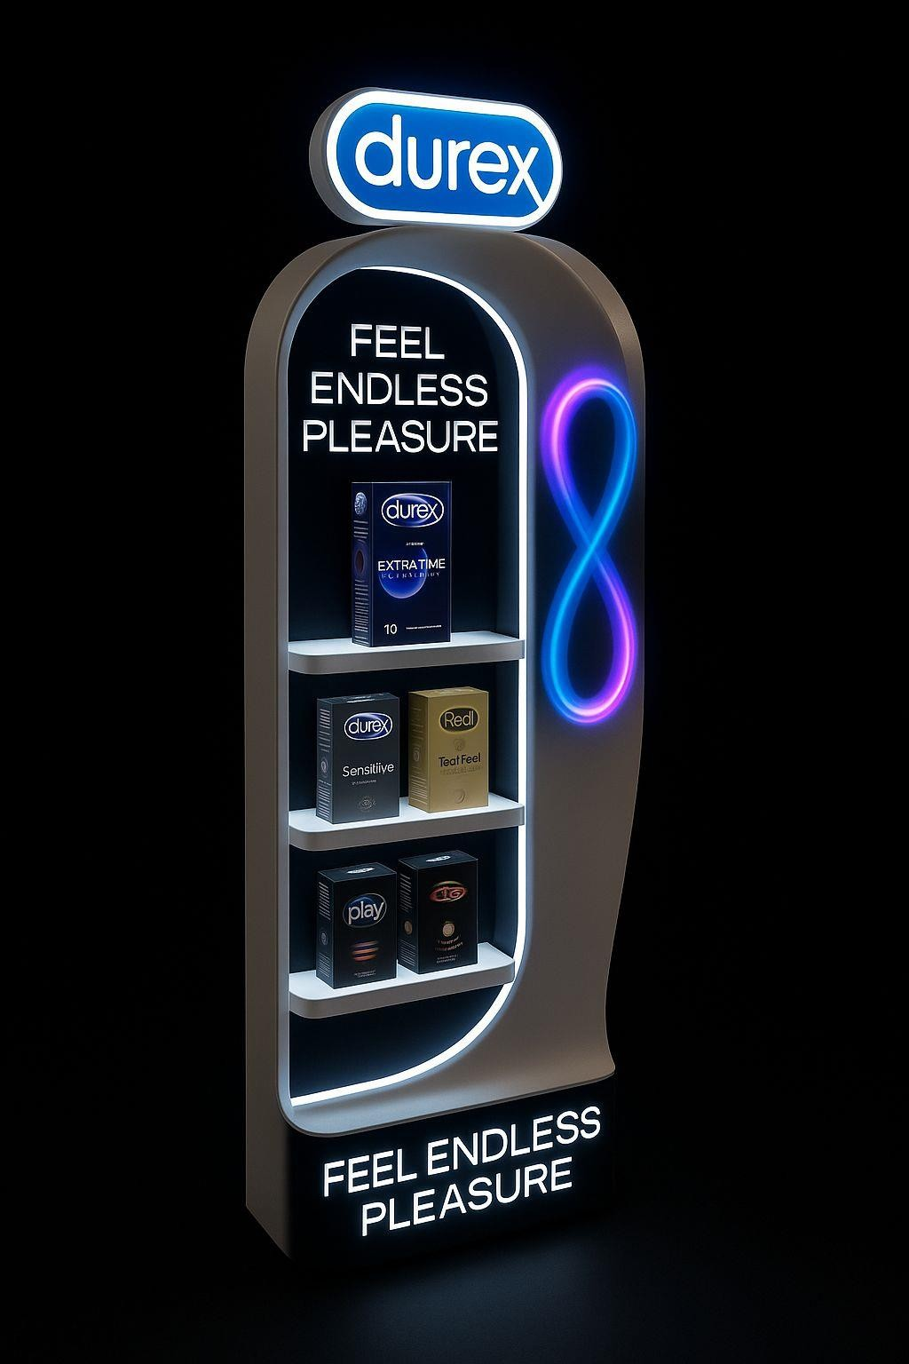
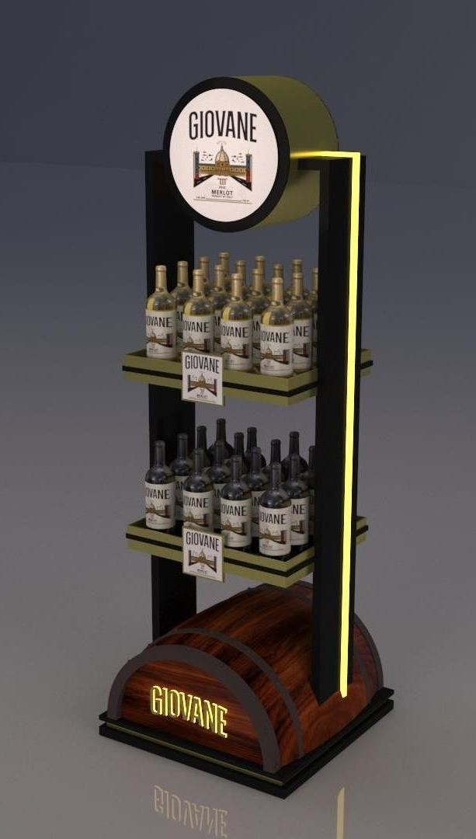
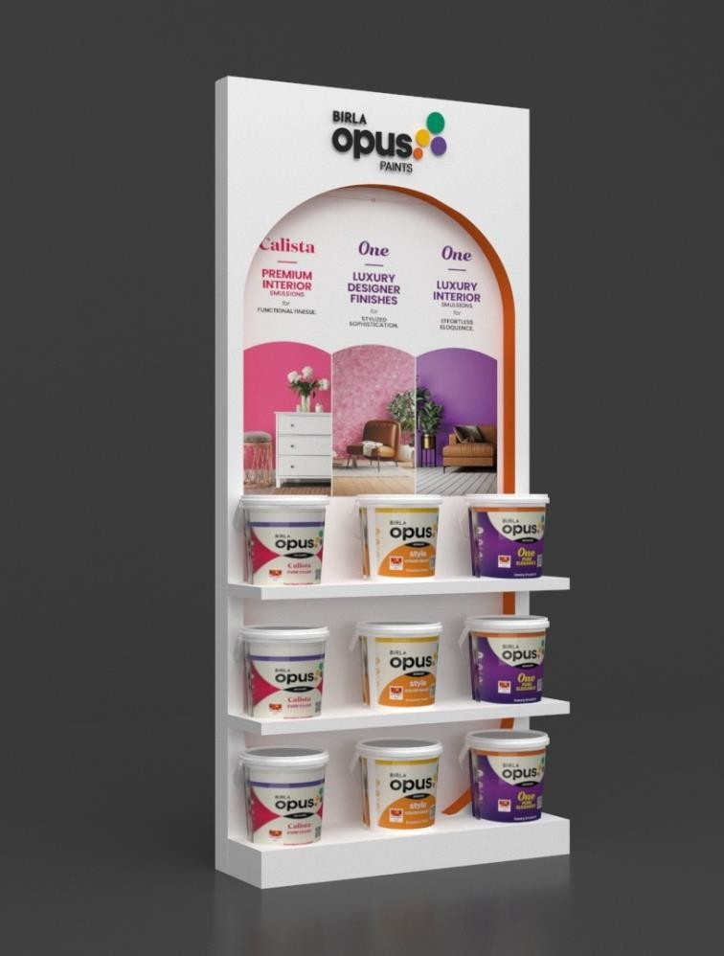
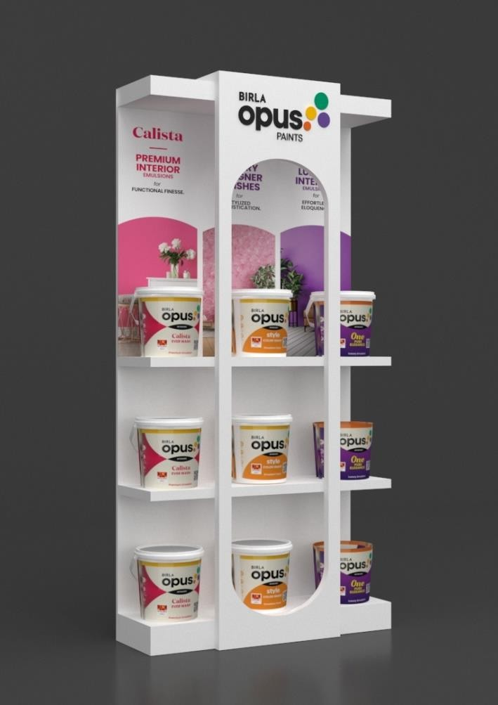
Floor Standing Unit

Slide 15
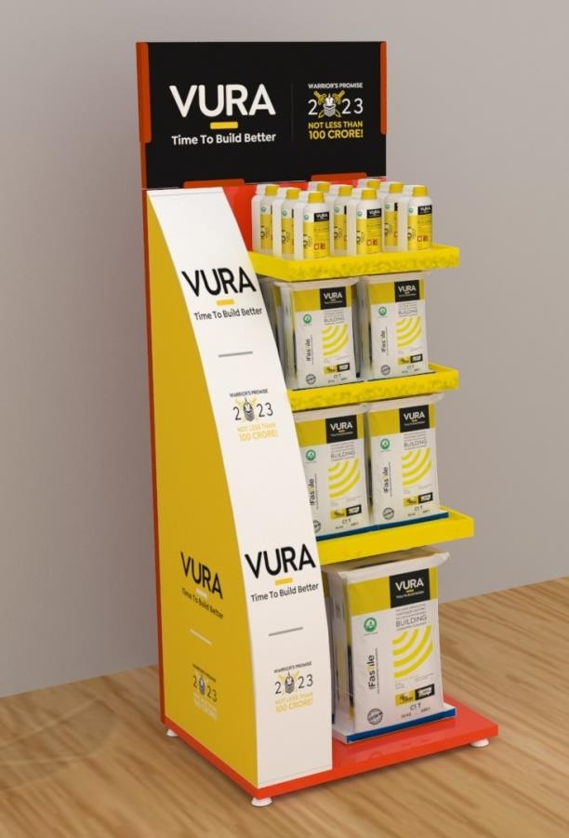
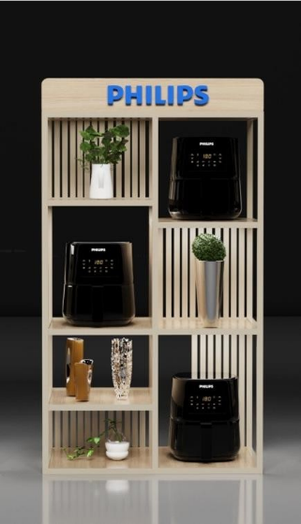
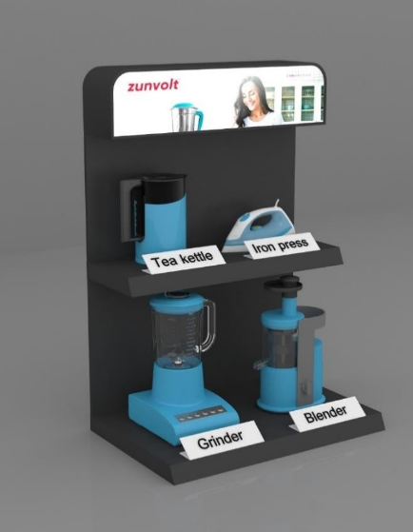
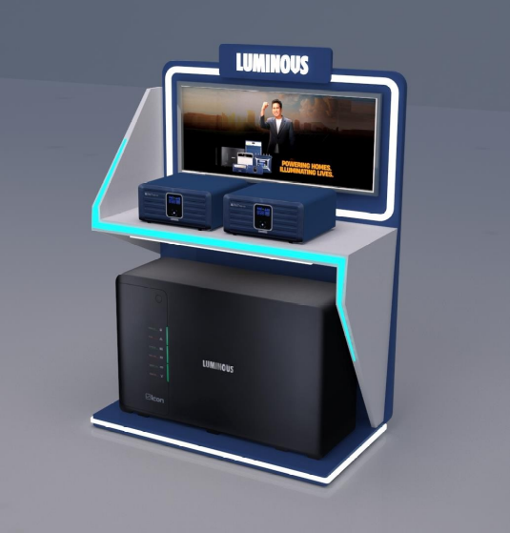
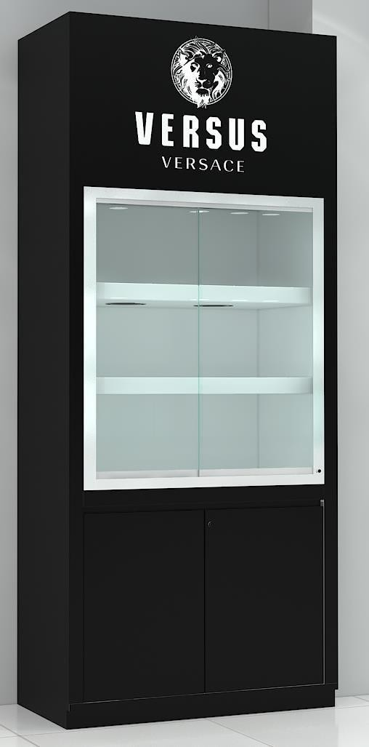
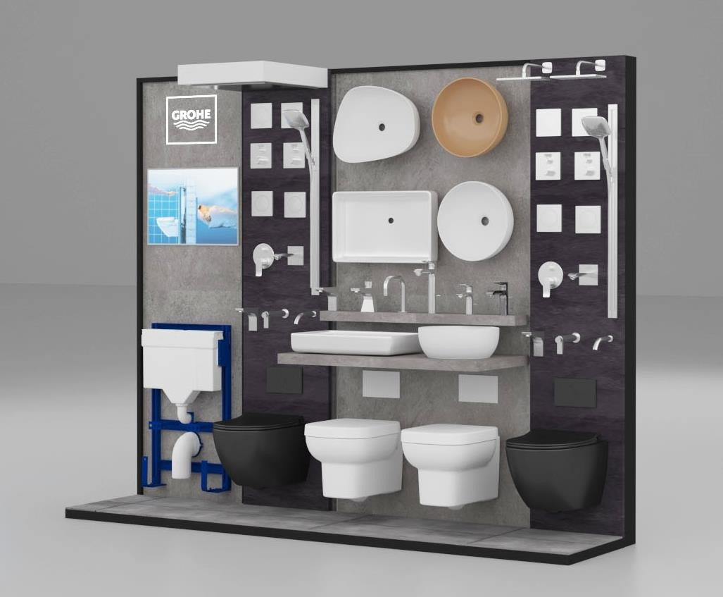
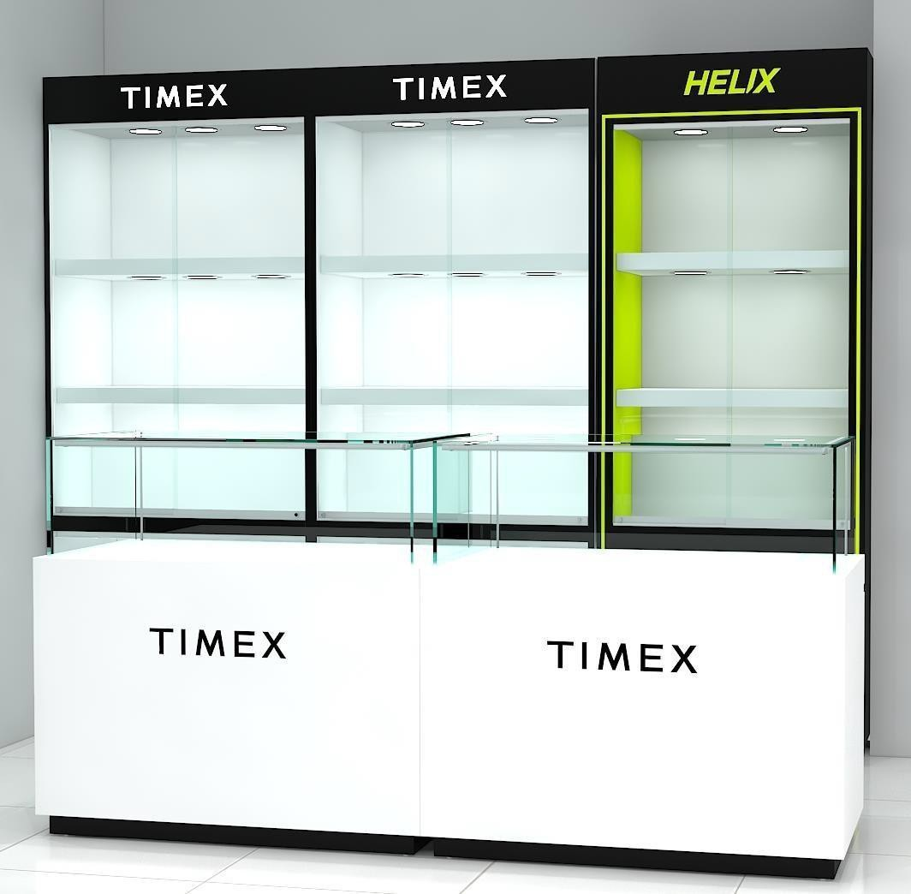
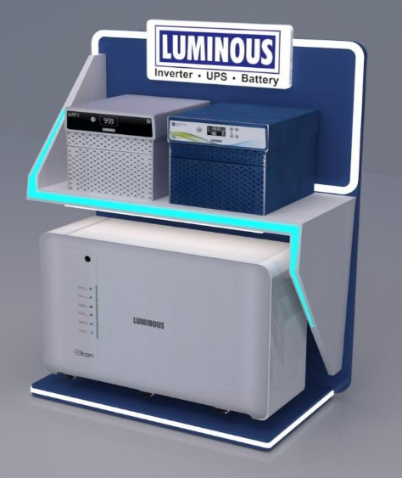
Floor Standing Unit

Slide 16
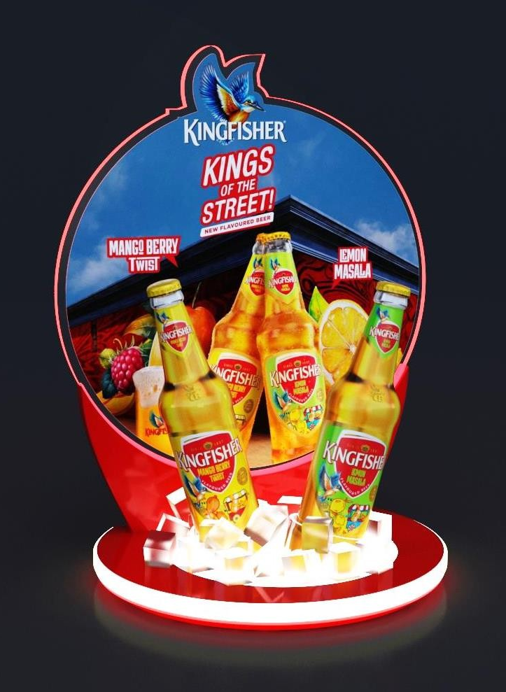
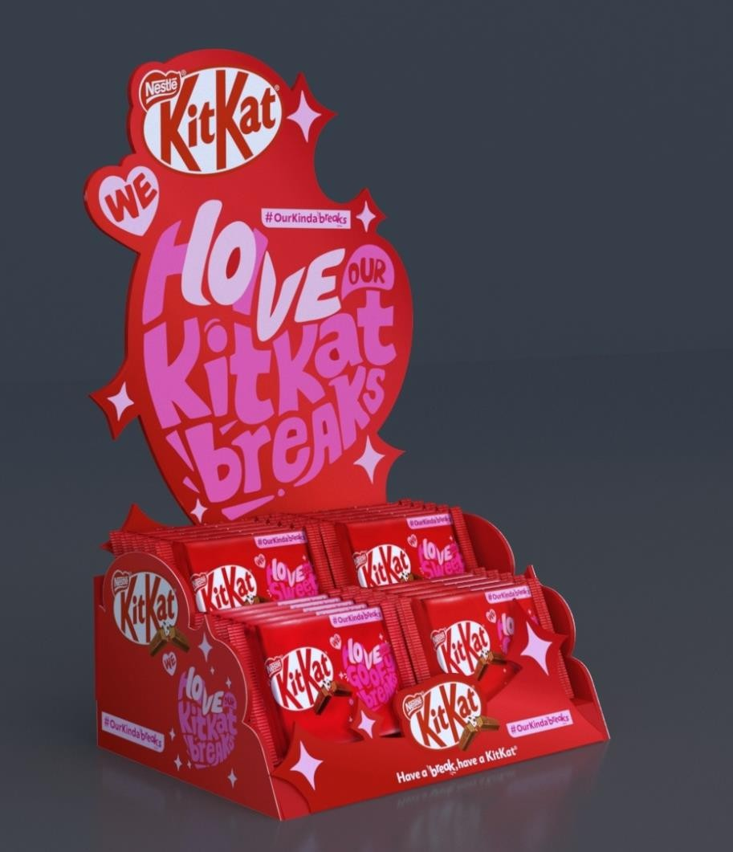
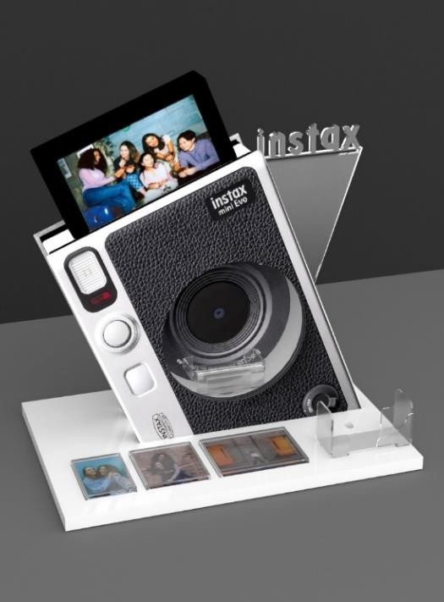


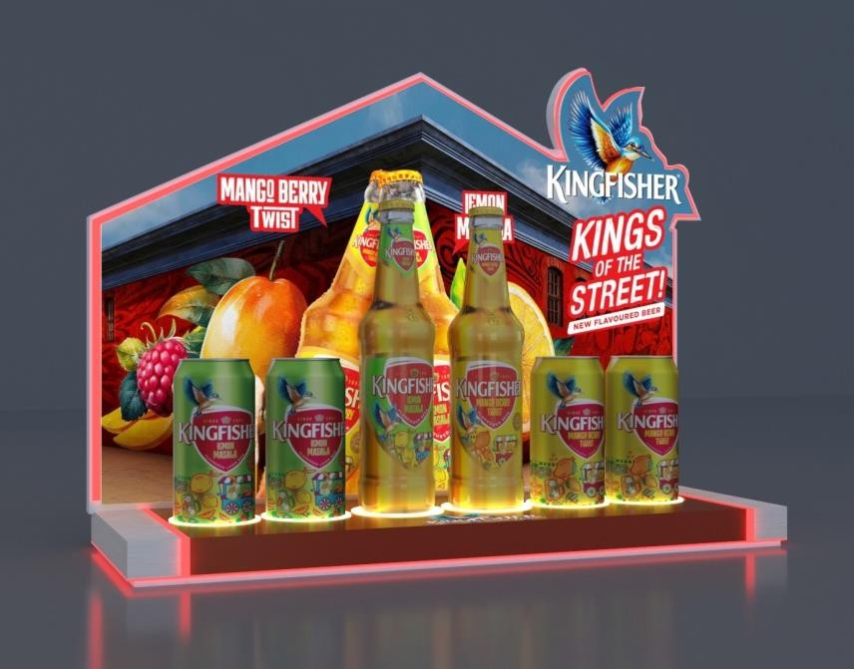
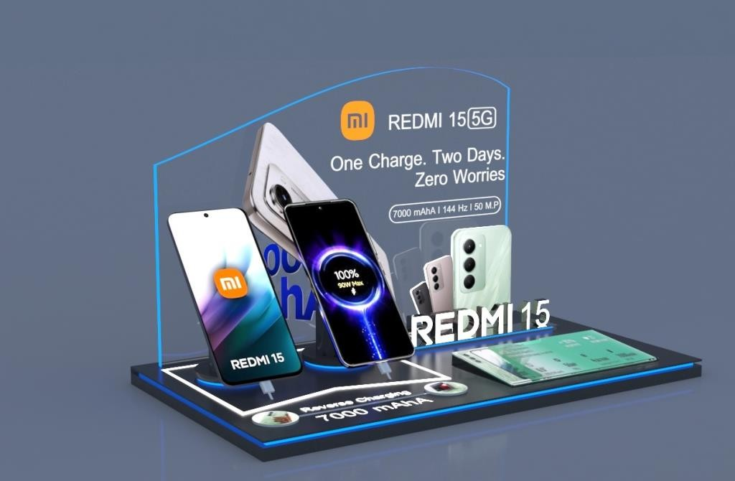

Table Top Unit

Slide 17
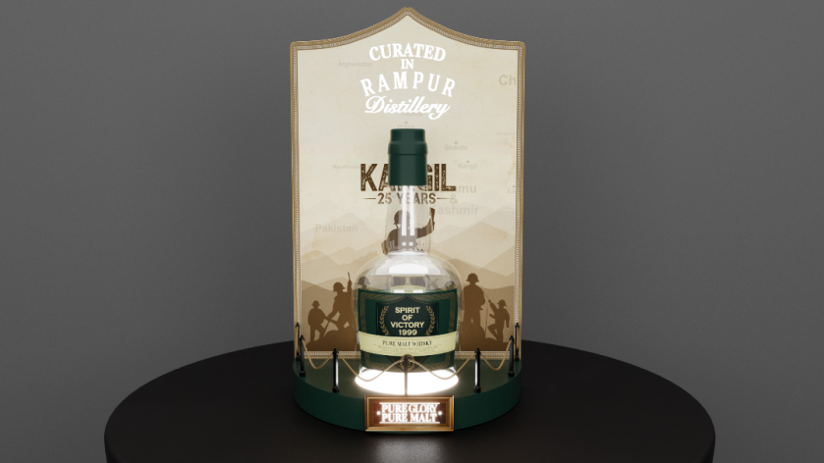
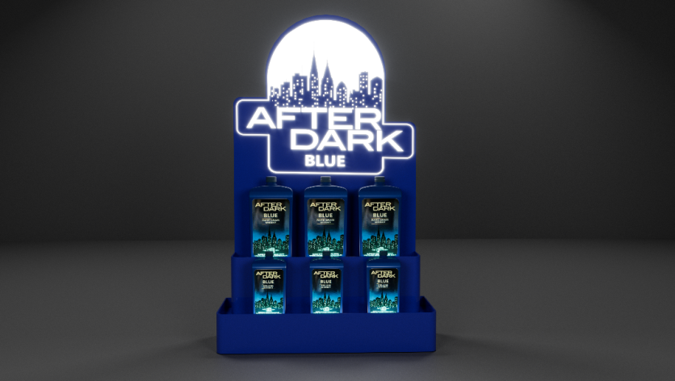

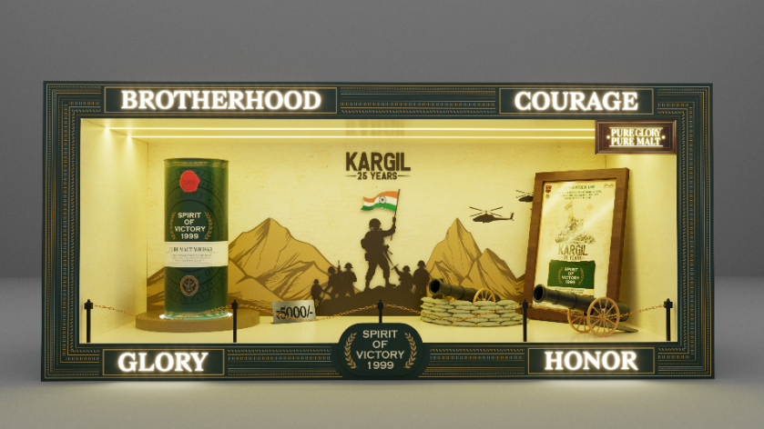
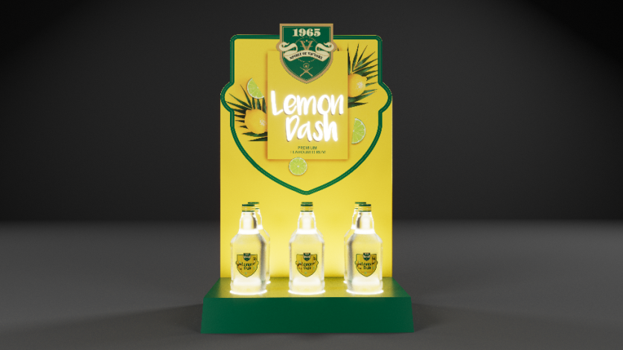
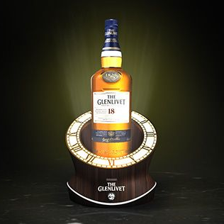

Table Top Unit

Slide 18
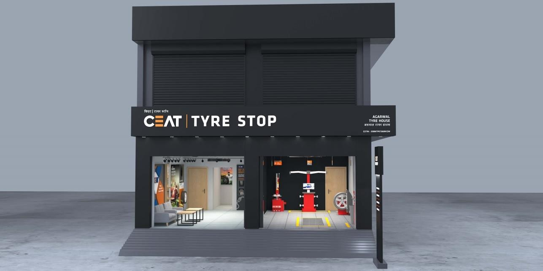
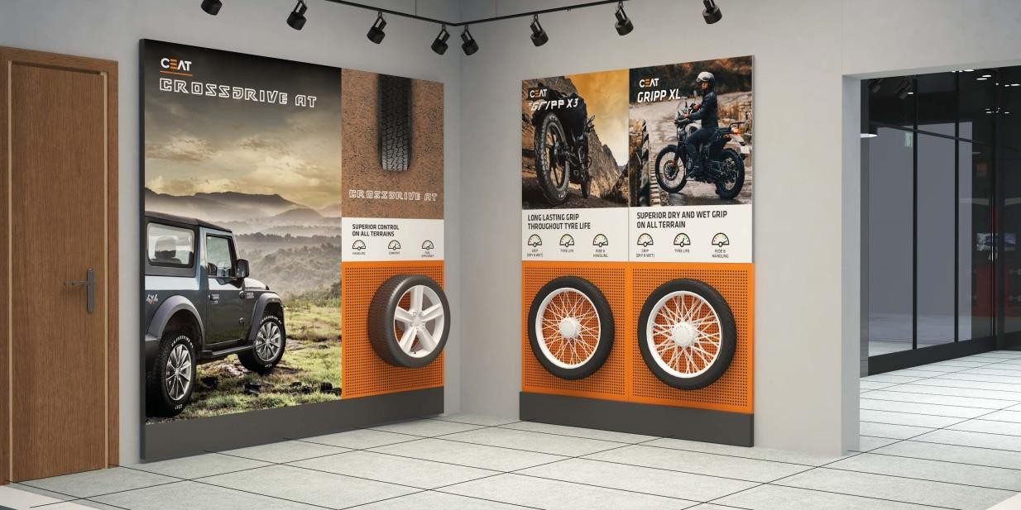
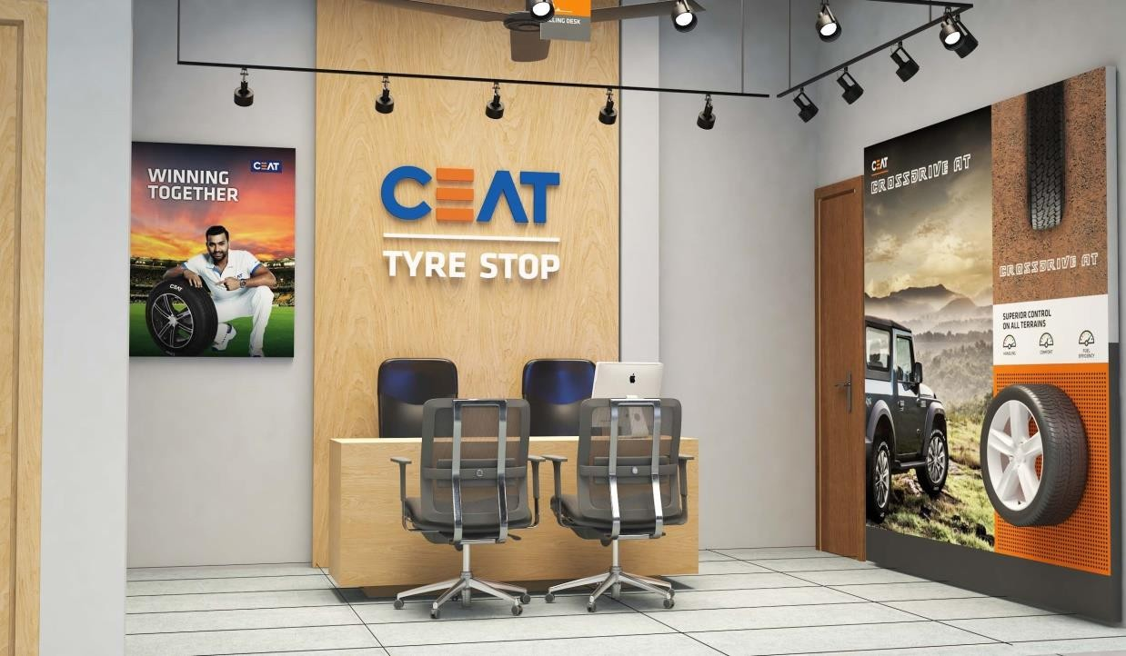
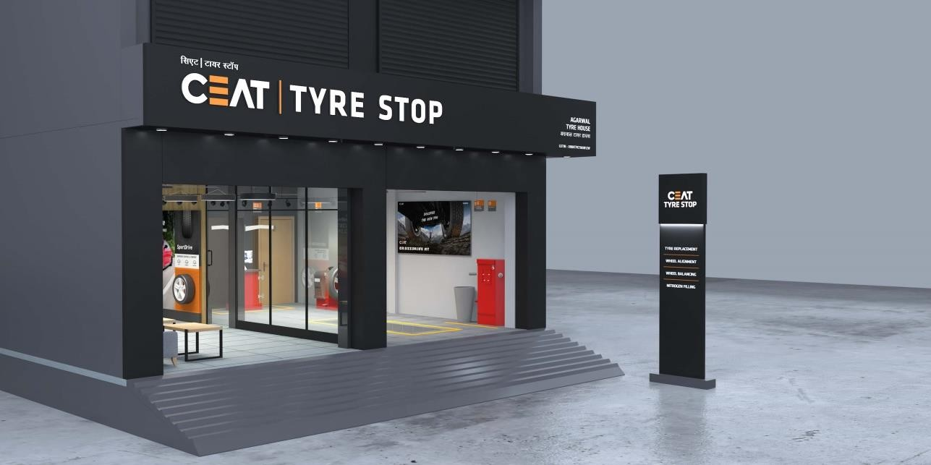
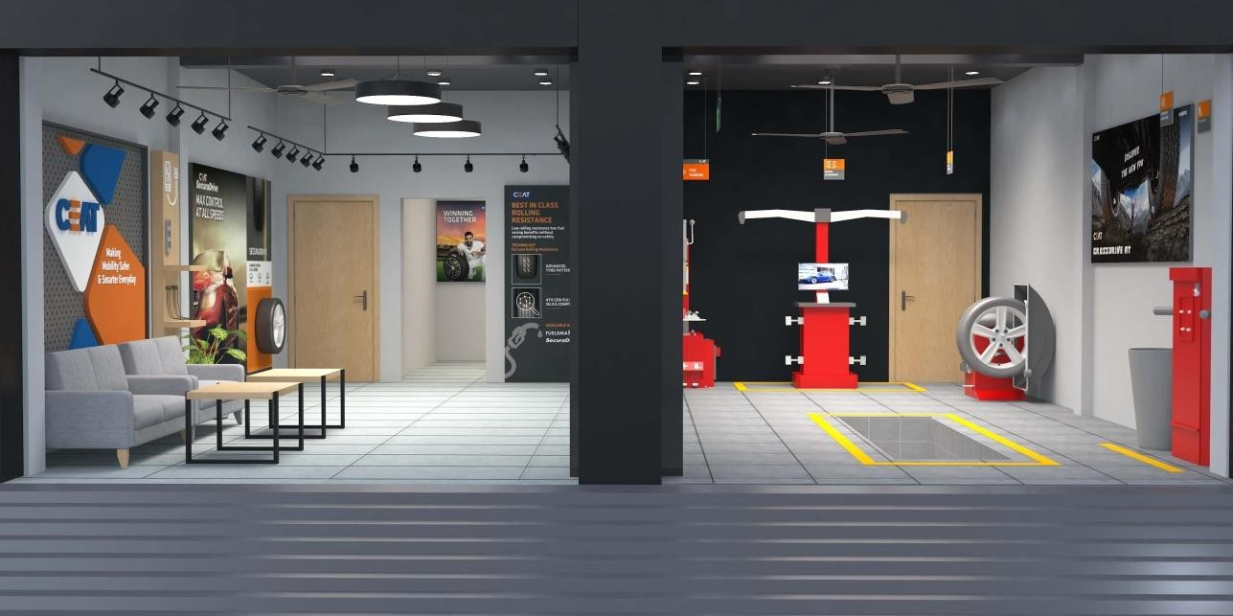
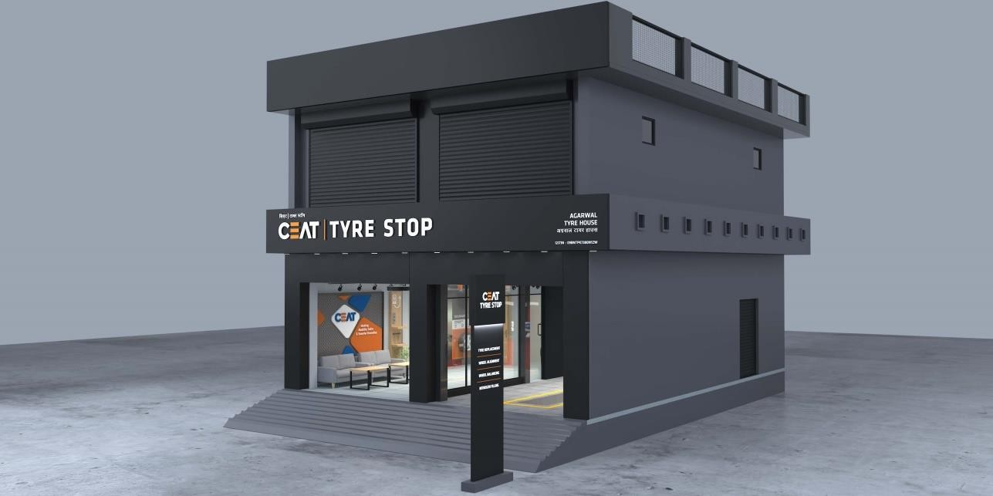
Ceat Tyre Stop Store

Slide 19
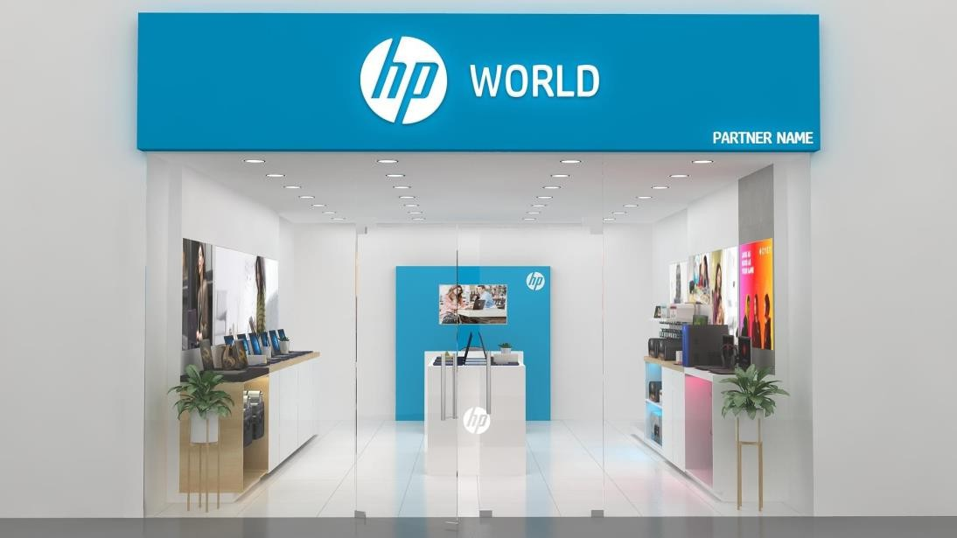
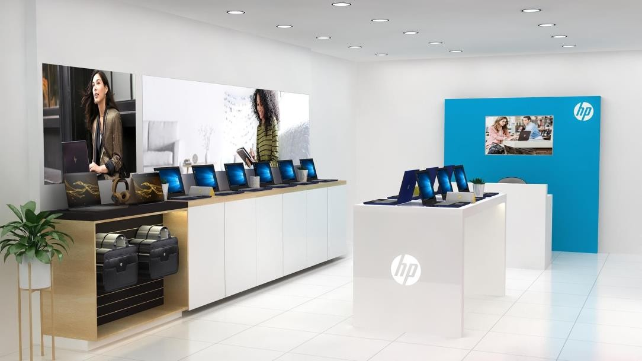
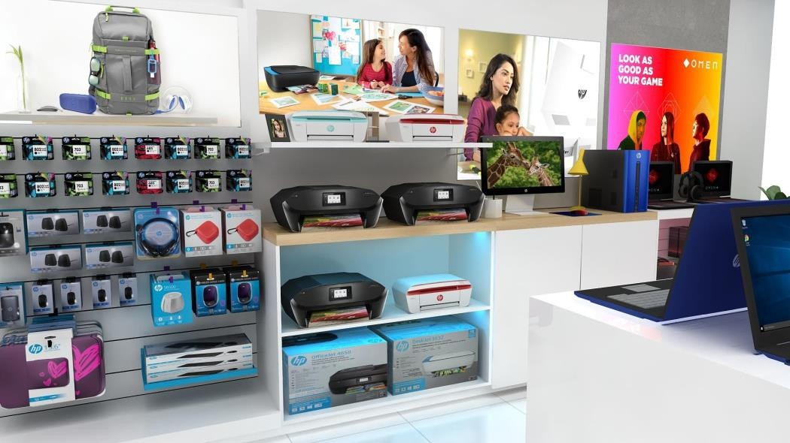
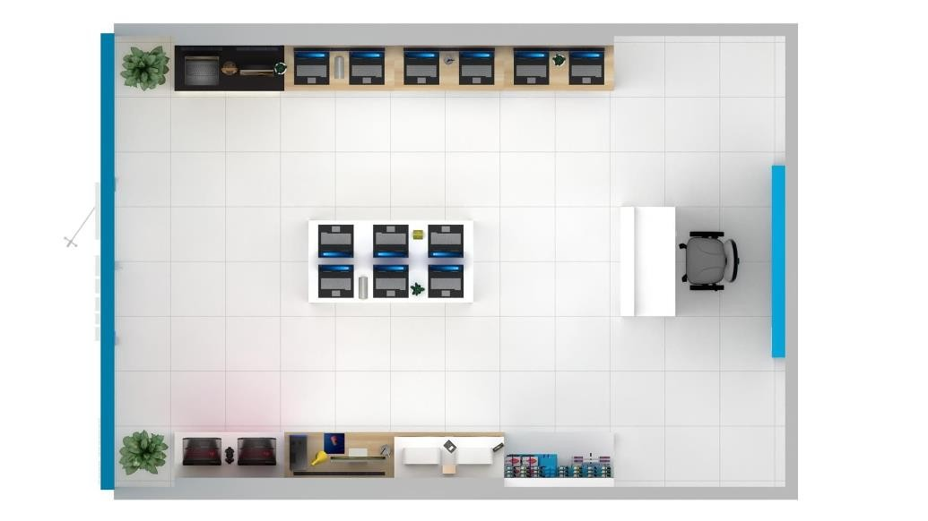
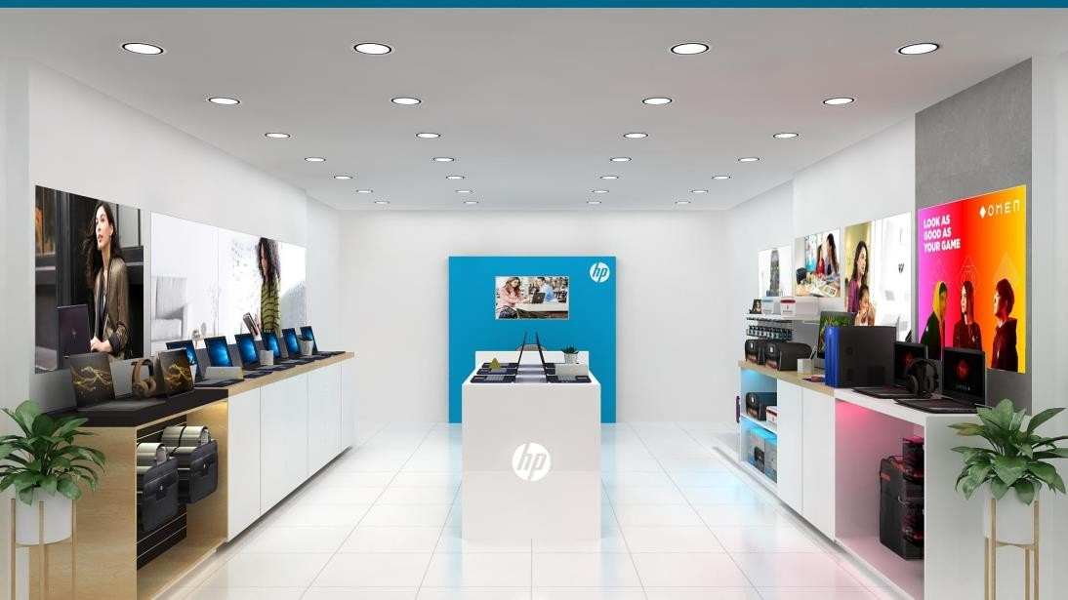
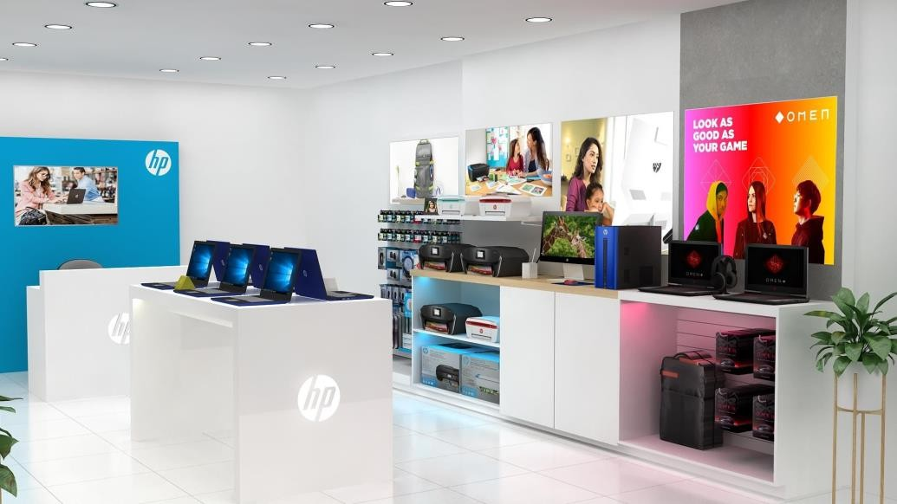
HP World Store

Slide 20
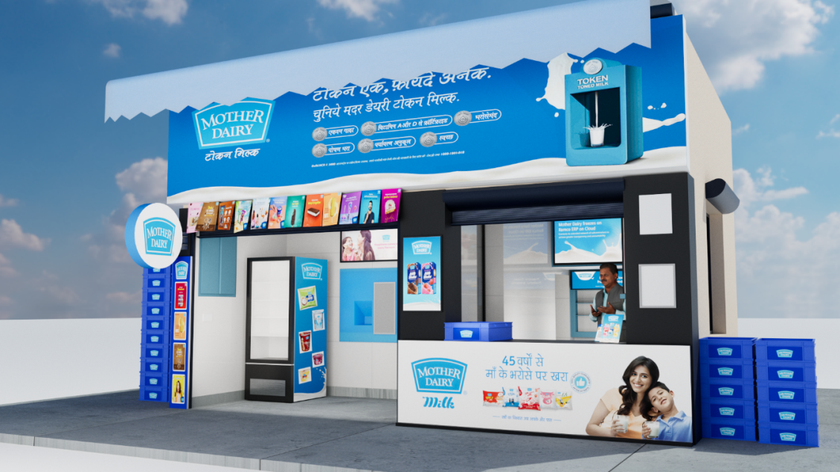
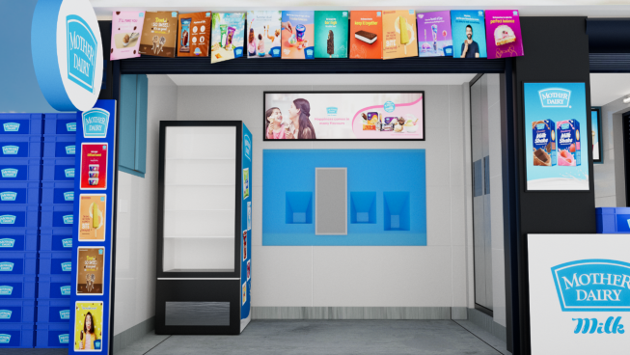






Mother Dairy Booth

Slide 21
MAJOR BRAND PROJECTS

Slide 22








Pepsi Campaign

Slide 23




Pepsi Campaign
Appreciation for timely work completion
We would like to appreciate the good work done by whole team of lakshya signage's in past
Few days of December 2021. The dedication. Hard work and commitment
Shown by you and your team is commendable. We heartily thank you for the wonderful show during CEO visit
And wish you keep up the same passion in our further jobs.
Regards,
Arpit Jothari

Slide 24






OYO Campaign

Slide 25




OYO Campaign
Appreciation for Excellent Signage Boards Work
I Wanted to take a moment to express my sincere appreciation for the exceptional work your team did not our recent signage board project. The final product exceeded our expectations, and we are thrilled with the result.
Thank you again for your excellent services.
Regards,
Ved Prakash

Slide 26
RETAIL STORE PROJECTS

Slide 27







KFC Store

Slide 28





Pizza Hut Store

Slide 29





Kohler Artist Edition Store

Slide 30






Sparx Store

Slide 31




Zouk Store

Slide 32







Omen Playground Store

Slide 33
FIXTURES & DISPLAY SYSTEMS

Slide 34



Flite Wall Unit

Slide 35






Sparx Wall Unit

Slide 36




Parryware Wall Unit

Slide 37


Havells Wall Unit

Slide 38


Zoom Wall Unit

Slide 39



Floor Standing Unit

Slide 40


Acrylic Table Top Unit (Lit & Non-lit)

Slide 41



Bausch + Lomb Counter Top Unit

Slide 42




Kiosk Unit

Slide 43


Bar Counter Unit

Slide 44
SIGNAGE PORTFOLIO

Slide 45


Categories Signage (Lit & Non-lit)
Non-Lit Signage
Back-Lit Signage
Front-Lit Signage
Glow Sign Board (GSB)
ACP Signage
Fabric Signage

Slide 46







Non-lit Sign Board

Slide 47






Back-lit Signage

Slide 48






Front-lit Signage

Slide 49





Glow Sign Board (GSB)

Slide 50






ACP Signage

Slide 51







Fabric Signage

Slide 52



OYO Sunday Hotel Outdoor Signage

Slide 53


Asian Paint – Outdoor Signage

Slide 54
SHOP & RETAIL
BRANDING DISPLAY

Slide 55



LED – Clip On Frame Board

Slide 56



Thermoforming Flanges

Slide 57




General Trade Thermoforming Poster

Slide 58



ABS / Non-lit Flanges

Slide 59



LED – With UV Print Flanges

Slide 60



Block-Out With Flasher Wall Display

Slide 61
PRINTING PORTFOLIO

Slide 62






Categories Printing
Flex Printing
Vinyl Printing
UV Printing
Embossed UV Printing
Offset Printing

Slide 63





Flex Print

Slide 64







Vinyl Print

Slide 65






UV Print

Slide 66






EMBOSSED UV Print

Slide 67







OFFSET Print

Slide 68
PROMOTIONAL ITEM

Slide 69

Sunpack Dangler & Cut-Out

Slide 70







Promotional Canopy
Gazebo Tents
Canopy Frame
Promotion Pop Up Table

Slide 71

Advertising Balloon

Slide 72






Led Advertising Screen Video Wall Display (indoor / Outdoor)

Slide 73






Human Walker Advertising

Slide 74






Custom QR Code Print for business

Slide 75




Standee
MS Brochure Stand
Tripod Easel Stand
Wooden Easel Stand

Slide 76













Banner Standees
Premium Black Roll Up Stand
D-Silver Roll Up Stand
Hexagon Double Side Roll Up Stand
Poster Stand
Economic Roll Up Stand
Luxury Roll Up Stand
Bridge Banner Stand
Adjustable Backdrops

Slide 77

Umbrella & Rollup Standee

Slide 78



Promo Table & Canopy

Slide 79


Our Digital Services
Social Media
Management​
Performance
Marketing & SEO
LinkedIn
Personal Branding
Photography
& Videography
Influencer
Marketing
Branding
& Design
Website
Development
Strategy &
Content Creation

Slide 80

Social Media Management
"At The Lakshya Signage, social media isn’t just about posting, it’s about positioning"
We build a consistent and memorable digital presence that reflects your brand’s voice and drives community engagement. Every post has purpose. Every move is backed by strategy.
Account Setup & Optimization
Monthly Content Calendar
Caption & Copywriting
Scheduling & Publishing
Engagement & Community Building
Monthly Insights & Reporting

Slide 81

Linkedin Personal Branding
"People follow people"
We built your brand from scratch and now helps founders do the same. We turn your ideas, values, and story into a strong digital presence that builds authority and opens new doors.
LinkedIn Profile Optimization
Content Strategy for Founders
Personal Brand Photoshoots
Thought Leadership Content
Storytelling-Based Posts
Profile Growth & Engagement Strategy

Slide 82

Performance Marketing & SEO
"We don’t burn ad budgets. We invest them smartly"
Our performance marketing approach combines powerful creatives, data-backed targeting, and continuous testing to ensure that every rupee spent works harder and smarter.
Meta Ads (Facebook & Instagram)
Google Ads (Search, Display, YouTube)
Landing Page Strategy
A/B Testing & Conversion Optimization
Budget Planning & Media Buying
Weekly Performance Reports

Slide 83

Photography & Videography
"Visuals that tell a story - that’s our lens"
Whether it’s an aesthetic product flat lay or a founder interview that builds trust, our shoots are driven by your brand goals and executed by our in-house creative crew.
Product Photography
Lifestyle Shoots
Behind-the-Scenes Coverage
Interview/Founder Videos
Scripted Video Shoots
Studio & Outdoor Setups

Slide 84

Influencer Marketing
"We work with creators who actually influence"
Our influencer campaigns are rooted in credibility, creativity, and results. From Nano to Macro - we find voices that align with your brand and bring real conversations (and conversions) to life.
Influencer Shortlisting & Outreach
Campaign Strategy & Briefing
Contracting & Negotiation
Content Review & Coordination
Performance Tracking
UGC Creator Collaborations

Slide 85

Branding & Design
"Branding at The Lakshya Signages is about building identity with intention"
We help you look as good as you are with visuals that reflect your values, connect with your audience, and make you instantly recognizable in a cluttered world.
Brand Identity Design (Logo, Typography, Colors)
Brand Guidelines
Packaging Design
Campaign Visuals
Pitch Decks & Presentations
Print Collateral (Brochures, Banners, etc.)

Slide 86

Strategy & Content Creation
"We create scroll-stopping content that blends creativity with conversion"
From aesthetic visuals to snappy Reels, our content is designed
to not just look good - but actually perform. We craft content that talks with your audience, not at them.
Reels & Short-Form Videos
Static Posts & Carousels
Product Shoots
Founder-Led Videos
UGC-style Edits

Slide 87

Website Development
"Your website is your digital home"
We build websites that are functional, fast, and on-brand - designed to inform, impress, and convert. Every scroll, tap, and click is thoughtfully planned at The KSocial.
UI/UX Design
E-commerce Websites
Portfolio & Service Websites
Website Copywriting
Mobile Optimization
SEO Basics Setup

Slide 88

















Clientelle
Trusted by 100+ Leading Brands :-
and more………

Slide 89


Contact Us
Our Team
FOUNDER
SUNNY THAKUR
+919818807979
DIRECTOR ( PRODUCTION )
AKASH DHANKANI
+919899978685
DIRECTOR ( TECHNICAL )
GIREESH NANDWANI
+919999781770

Slide 90
















Connect With us on Social Medial
LAKSHYA SIGNAGES

